Slide 1
Real estate market analysis of central Seattle neighborhoods
By Viktar Khutko
Notes:
Timothy Stevens
Seller
Owns expensive houses in the center, needs to get rid, best timing within a year, open for renovation when profits rise
King County (USA) DC Washington

Slide 2
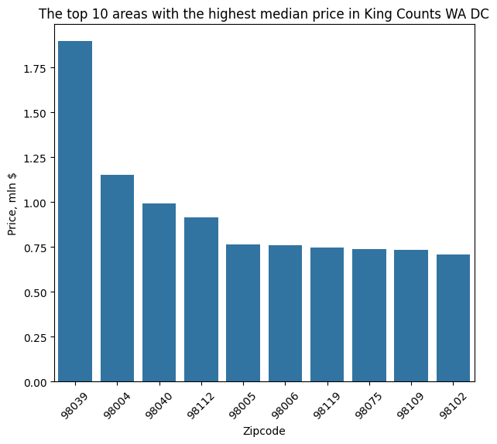
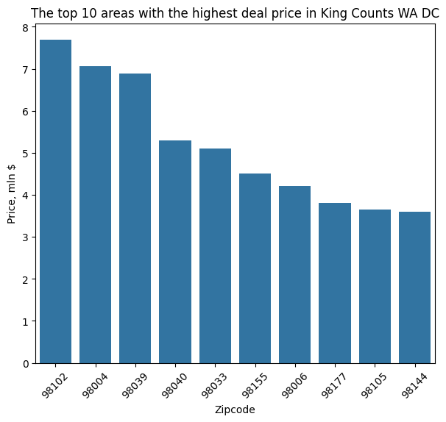
High priced areas
Notes:
First, it was necessary to clarify which specific districts were being referenced. I analyzed districts with the highest median and maximum prices.
3 areas where in both lists
98039 – Medine
98004 – Bellevue, etc.
98040 – Mercer Island

Slide 3
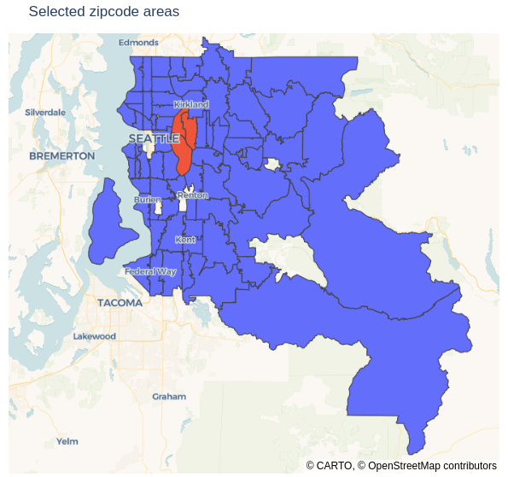
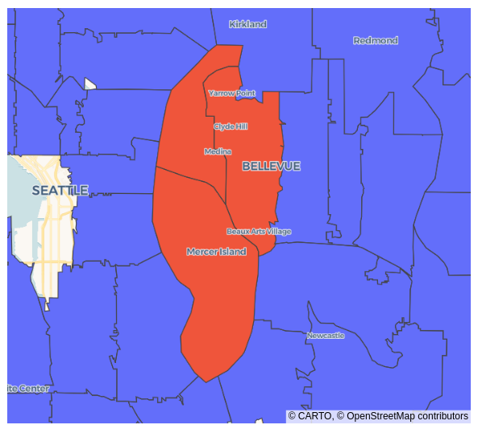
High priced areas
98039 - Medine
98004 – Bellevue, etc.
98040 – Mercer Island

Slide 4
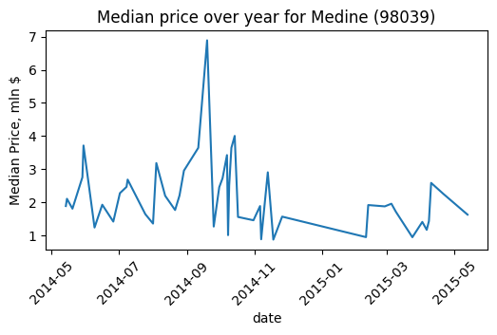
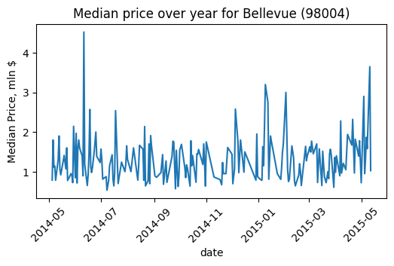
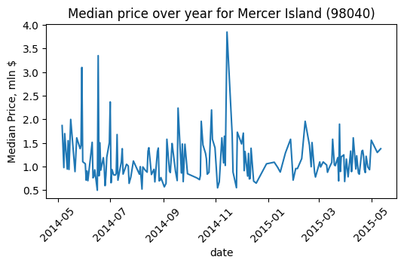
Trends specific to area
Notes:
seasonal price trends to determine the most profitable time to sell real estate.
- After examining price fluctuations per district, the results were inconclusive.
- While price volatility was higher in spring, the overall trend remained unclear—likely due to limited transaction data in these areas.
- However, periods with greater price fluctuations still present opportunities to sell at higher prices compared to stable periods.
Medine, Bellevue and Mercer Island - Highest volatility occurred in spring, while the Bellevue and Mercer Island Districts has significant price swings in winter too.
As a conclusion - to sell the property in spring.

Slide 5
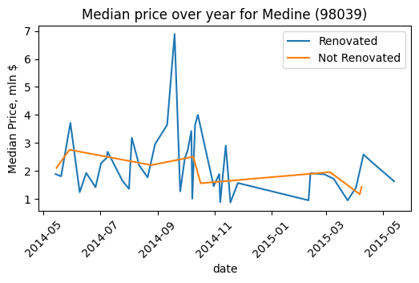
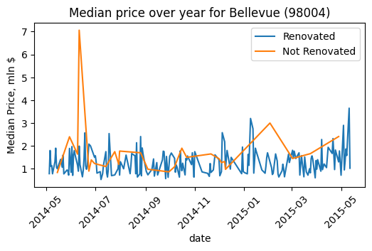
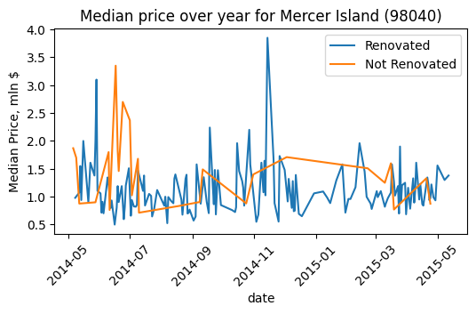
Renovation
Notes:
Renovated properties consistently sold in mid-to-high price ranges.
- The most significant premium appeared during previously identified active seasons: In spring, renovated properties outperformed non-renovated ones across the board. In districts Bellevue and Mercer Island, this effect extended to winter sales.
While renovations universally added value, their price-boosting power intensified during high-activity periods—aligning with the earlier volatility patterns.

Slide 6
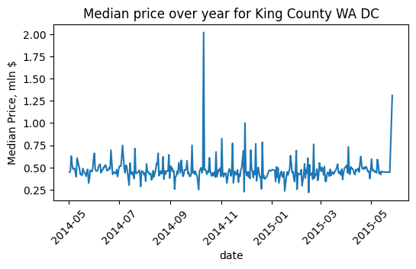
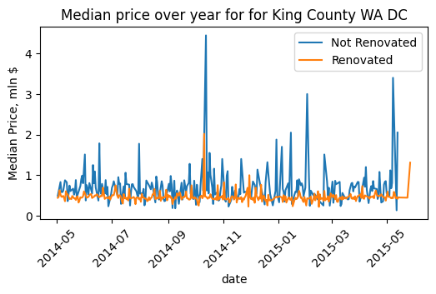
Is it similar to the whole King County?
Notes:
It’s widely accepted that real estate prices in this region typically rise in spring, as buyers aim to close deals for summer occupancy.
However, during the analyzed period:
Seasonal price fluctuations were unusually muted. The unseasonably warm winter of 2014–2015 reduced the typical winter slowdown, sustaining transaction activity
The King County unique profile can also explain anomaly of stable prices. Primarily this area populated by high-earning IT professionals with stable purchasing power. But it has a limited inventory of new properties. Persistent high demand + low supply suppressed normal seasonal volatility

Slide 7

Ask Me Anything

